Slide 1
CICD PIPELINE WITH AWS

Slide 2
WHAT IS CICD ?
CI/CD stands for Continuous Integration and Continuous Delivery/Deployment.
It’s a modern software development practice used to automate building, testing, and deploying applications

Slide 3
1. CI – Continuous Integration
1. CI – Continuous Integration
Developers frequently merge (integrate) their code changes into a shared repository (like GitHub/GitLab/Bitbucket).
Each code change automatically triggers a build and test pipeline.
This ensures new code doesn’t break the existing application and catches bugs early.
Example: You push your code → pipeline runs → compiles code → runs unit tests → reports success/failure.

Slide 4
2. Continuous Delivery (CD)
After CI, code is automatically packaged and made ready for deployment.
Deployment to staging/production can be manual approval-based.

Slide 5
3. Continuous Deployment (CD)
Extends continuous delivery by automatically deploying every change to production after tests pass.
No manual intervention, fully automated delivery.

Slide 6
Stages of a Typical CI/CD Pipeline Source
Source
Code is pushed to version control (e.g., GitHub, GitLab, Bitbucket).
Build
Compile source code into executable artifacts.
Example: maven build, npm build, Docker image creation.
Test
Run unit tests, integration tests, static code analysis, security scans.
Deploy
Deploy build artifacts to staging, QA, or production environments.
Example: deploying to Kubernetes, AWS ECS, Azure App Service, or on-prem servers.
Monitor
Track application logs, metrics, and user feedback to ensure stability.

Slide 7
Tools Commonly Used
Version Control: Git, GitHub, GitLab, Bitbucket
CI/CD Servers: Jenkins, GitLab CI, GitHub Actions, CircleCI, Azure DevOps, AWS CodePipeline
Build Tools: Maven, Gradle, npm, Docker
Testing: JUnit, Selenium, Postman, SonarQube
Deployment/Infra: Kubernetes, Helm, Terraform, Ansible, AWS, Azure, GCP

Slide 8
AWS CodePipeline Overview
AWS CodePipeline is a fully managed CI/CD service on AWS. It automates the steps required to build, test, and deploy applications whenever there is a code change.
Key Features
Fully managed → no servers to maintain.
Integrates with AWS services like CodeCommit, CodeBuild, CodeDeploy, Lambda, ECS, EKS, S3.
Customizable → supports 3rd-party tools (GitHub, Jenkins, Bitbucket, SonarQube, etc.).
Pay-per-use → billed only for pipeline executions.
Fast delivery → automates from commit → build → test → deploy.

Slide 9
AWS CodePipeline Workflow
Source Stage
Triggered when code is pushed.
Sources: AWS CodeCommit, GitHub, Bitbucket, S3.
Build Stage
Uses AWS CodeBuild to compile code, run unit tests, create artifacts (e.g., Docker images).
Test Stage (optional)
Run automated tests (integration, load, security).
Can use CodeBuild, Lambda, or custom scripts.
Deploy Stage
Deploys to EC2, ECS, EKS, Lambda, S3 (static site), Elastic Beanstalk, CloudFormation.
Approval Stage (optional)
Manual approvals before production deployment.
Monitor Stage
Use CloudWatch, X-Ray, CloudTrail, SNS for monitoring & alerts.

Slide 10
Example AWS CodePipeline Flow
Developer pushes code → GitHub/CodeCommit.
Pipeline triggers → fetch source.
CodeBuild compiles app → runs tests.
Artifact stored → in S3 or ECR (if Docker image).
Deploy → ECS/EKS/EC2/Lambda/Elastic Beanstalk.
CloudWatch monitors performance.

Slide 11
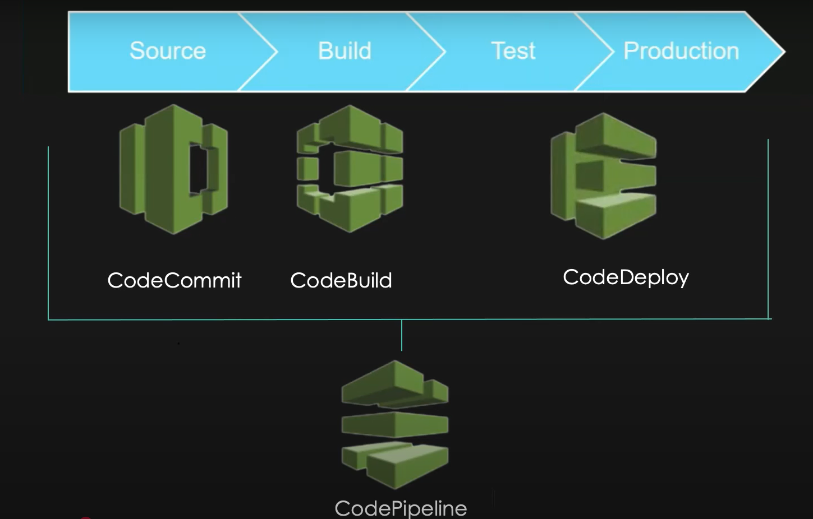

Slide 12
